Slide 1
How to Find Funding Using Key Words and Proper Databases
Office of Research
Research Program Development
www.research.ufl.edu/research-program-development.html
Jenn Hubbs
programdevelopment@research.ufl.edu
May 17, 2013

Slide 2
Topics covered
Where to find grant announcements
What kinds of keywords to use
How to determine which sponsors are right for your work

Slide 3
Finding Funding
What activity needs support?
(Research, dissertation support, organize a conference, travel to conferences, equipment…)
Develop keywords
Search databases
Sign up for email alerts

Slide 4
Funding Sources
Internal
Your Department & College
University-wide opportunities
External
Professional Organizations
Government Agencies
Foundations
List of graduate student opportunities: http://research.ufl.edu/research-program-development/external-funding.html (Look near the top for link to Graduate Student Funding Opportunities handout)

Slide 5
Graduate Student Travel Grants
Office of Research –Graduate Student Travel Fund
http://research.ufl.edu/research-program-development/internal-competitive-funding.html
Maximum $300 + 1:1 match by college/dept
Presentation at national meeting OR unique off-site research experience
Apply minimum 1 month before travel
Priority to doctoral-level students
UF Graduate Student Council –Travel Grants
http://gsc.sg.ufl.edu/grants/
$250 reimbursement-based awards, funding up to half of travel costs
For graduate students presenting their research or participating in professional development at conferences
Submit at least 6 weeks before conference

Slide 6
Finding Funding:
Where to Look
Research Program Development website provides information on external funding sources:
  http://research.ufl.edu/research-program-development/external-funding.html
Searchable Databases
  Federal opportunities: Grants.gov (www.grants.gov)
  Foundations: Chronicle of Philanthropy (http://philanthropy.com/deadlines/)
  GrantForward (formerly IRIS – https://www.grantforward.com)
  COS/Pivot
    Funding Searches and Funding Email Alerts
    To register: http://pivot.cos.com/ and click on “sign up” (top right) while on campus
    Create your Profile
    Funding alerts based on info in PI’s Pivot Profile (or can set up specific searches, save them and have them emailed to you as funding alerts)
Notes:
For most of these databases, UF has a subscription, but you can sign up while you’re on a campus network with your UF email address and then use those credentials to log in from off-campus in the future. Grants.gov is totally public.

Slide 7
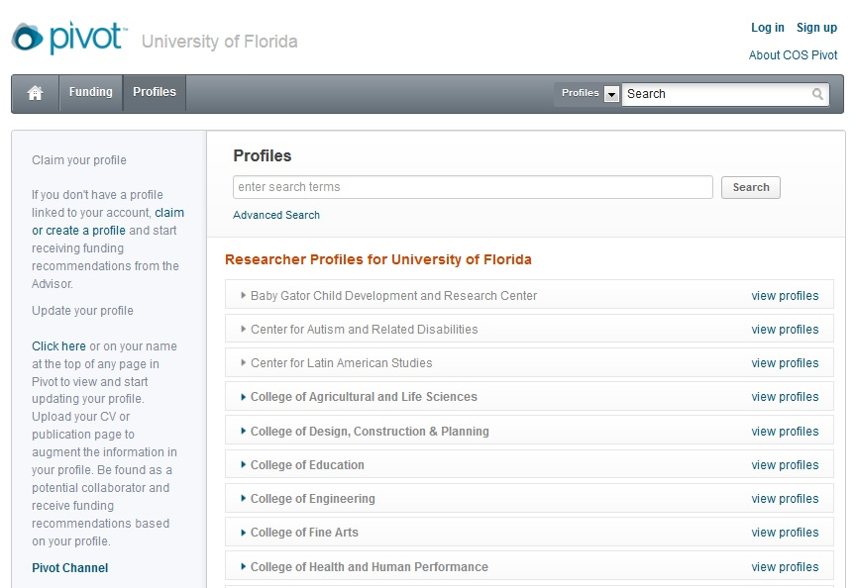
Can search for a profile here
Notes:
On pivot.cos.com, using the “Profiles” tab, you can search for the profile of anyone – yourself (as a grad student, you are unlikely to have one already, but you can create one using the instructions on the site), your advisor, others whose work you are interested in…) or browse through the profiles already on the site by college/department, but be aware that Pivot doesn’t always perfectly categorize everyone if they haven’t claimed their profile.

Slide 8
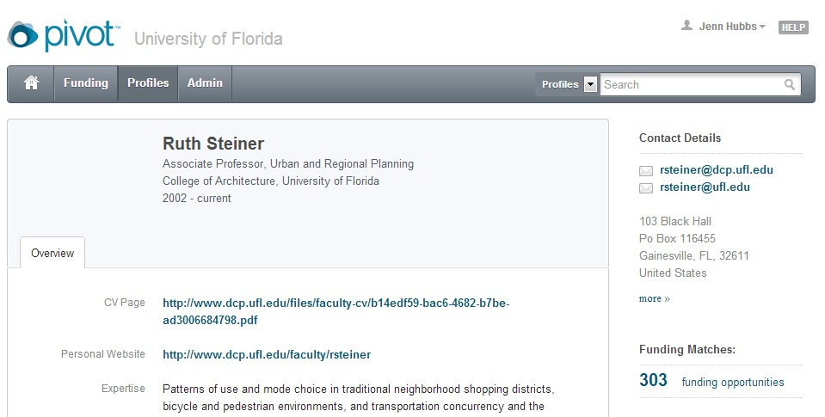
Established scholars mostly already have profiles
Notes:
Pivot has staff who use UF webpages to create profiles for UF researchers (mostly faculty), generating automatic keywords from their CVs and publications, and then making an automatically matched list of potential funding opportunities based on those keywords.

Slide 9
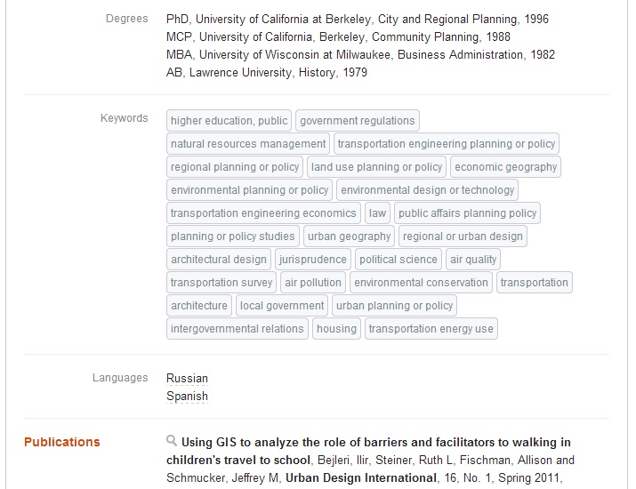
Notes:
Here is an example list of keywords based on one professor’s CV/publications. There may be some “false positives,” especially if they collaborated on a publication that’s not directly in their field of expertise, but those who claim their profile can add and remove keywords as they prefer.

Slide 10
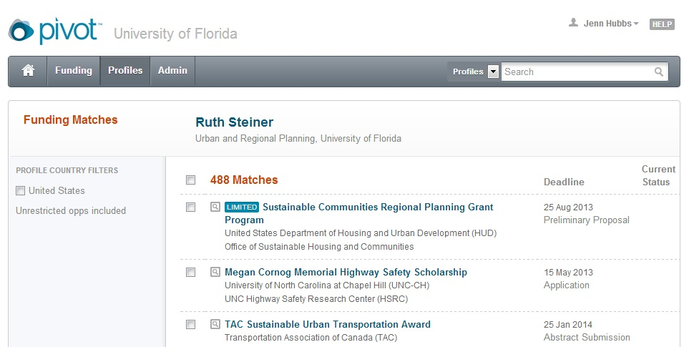
Notes:
Clicking on the “[xx] Funding Opportunities” link on a profile will take you to a results list of automatically-matched opportunities based on those generated keywords associated with the profile. Some may be irrelevant to the person’s research, but others may be useful.

Slide 11
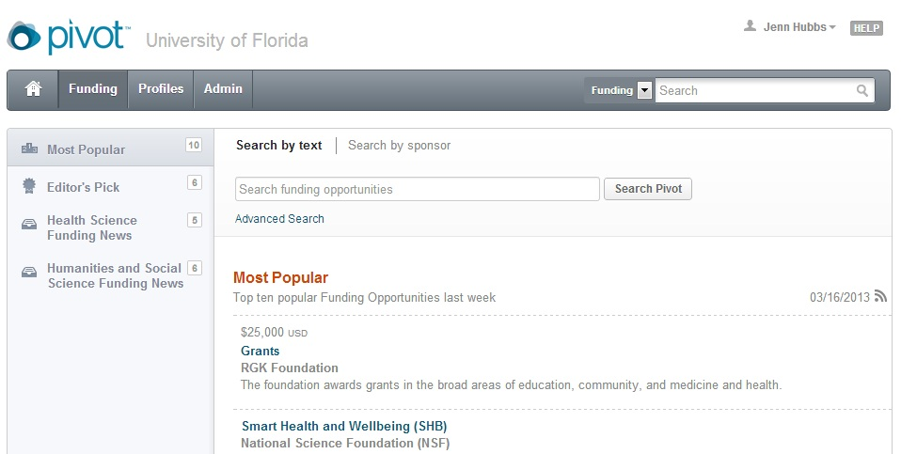
Notes:
Rather than just using profiles and automatically-matched opportunities, you can also search for funding opportunities directly, whether or not you have or have claimed your profile, using the “Funding” tab. Generally, the “Advanced Search” option works best.

Slide 12
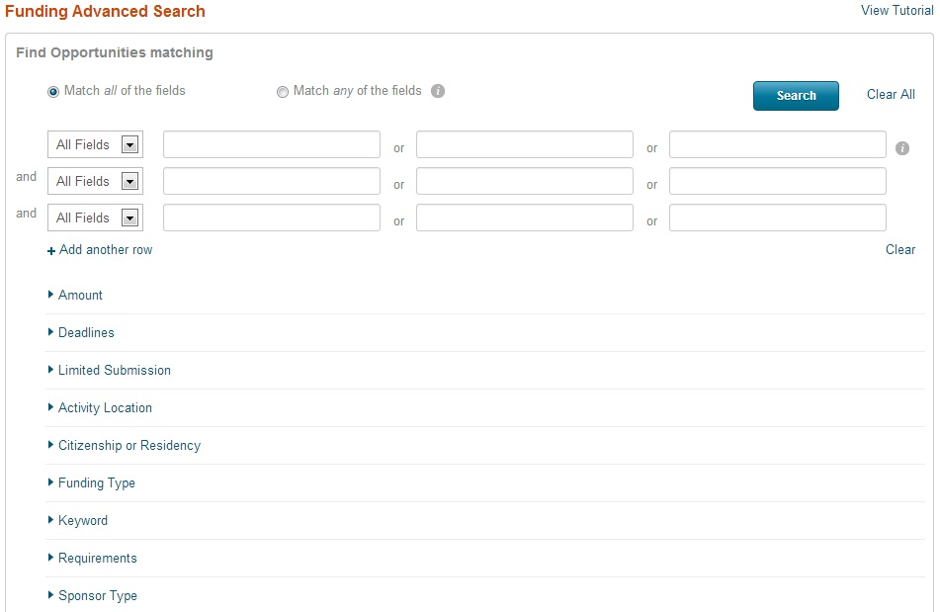
Notes:
On the Advanced Search page, we find it most useful to use these four fields (rather than or in combination with the free-form search fields above): Activity Location, Funding Type, Keyword, and Requirements.
A note on citizenship/residency – it’s often best to avoid limiting your search to those open only to those of your own citizenship/residency. We find that the main way this option is useful is to scroll down to the section below all of these fields, where you can specify what NOT to show, and exclude those that require US citizenship if you are not a US citizen.

Slide 13
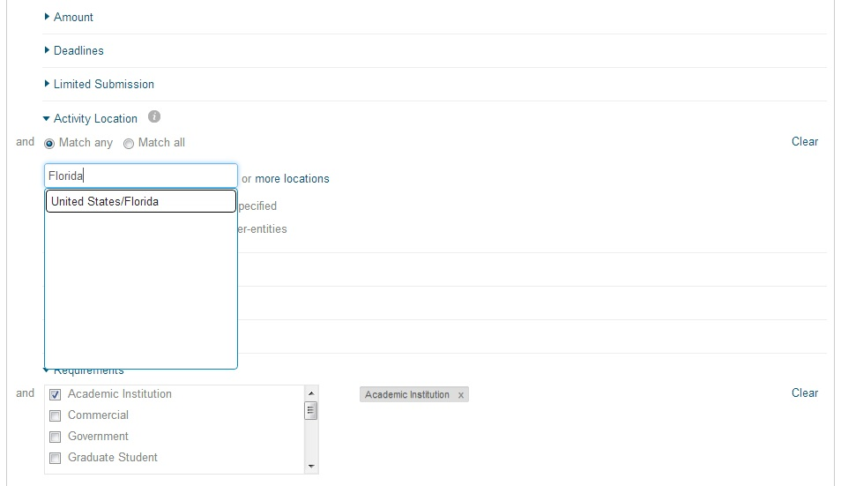
Notes:
First, limit the activity location to Florida. This will include opportunities that are valid anywhere in the US or anywhere in the world, but will exclude, for instance, most foundations only funding work in Ohio.

Slide 14
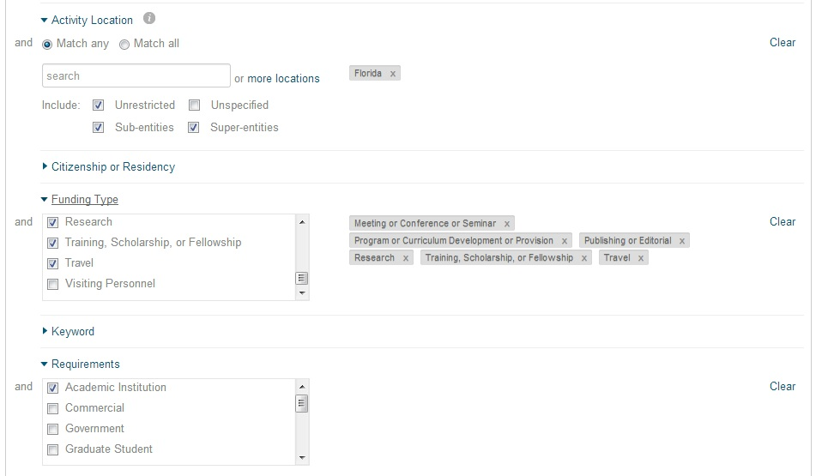
Notes:
There are a variety of funding types to choose from; you can make it broad or narrow (for instance, only searching for travel grants, or only research grants).
For “Requirements,” we usually choose “Academic Institution” to filter out grants for, say, city governments. You can try selecting “Graduate Student” and see what comes up, but sometimes this artificially limits the number of results you get – just because Graduate Student isn’t a *requirement* to apply doesn’t mean you can’t apply.

Slide 15
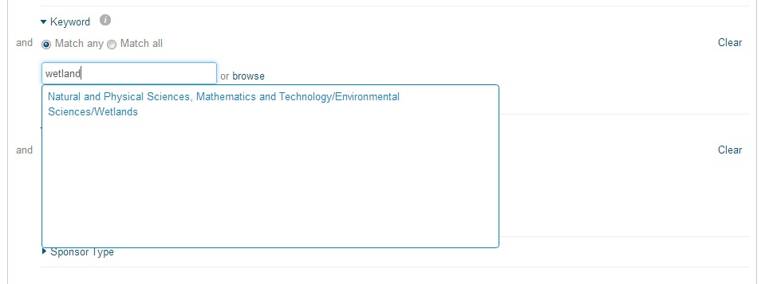
Think outside the box (and as broadly as possible) for keywords
Notes:
COS/Pivot has a robust set of keywords, making it a great first place to start searching for ideas on what keywords to use. Start typing a word and you’ll usually find one or more categories it matches.

Slide 16
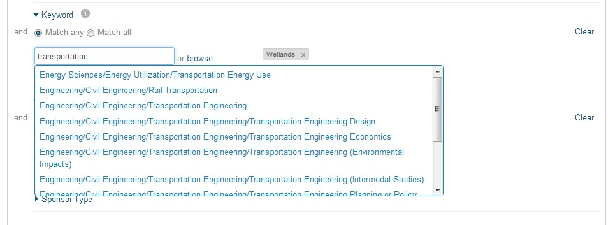
Check the “Explode” checkbox in this section to include all “child” keywords in your search
Notes:
Think broadly – there may be multiple relevant keywords for you. If you check the checkbox with “explode” next to the search box, then selecting “Transportation Engineering” will also include opportunities tagged with the subcategories under that tag, like “Transportation Engineering Design” – meaning you’ll have fewer categories to manually pick.

Slide 17
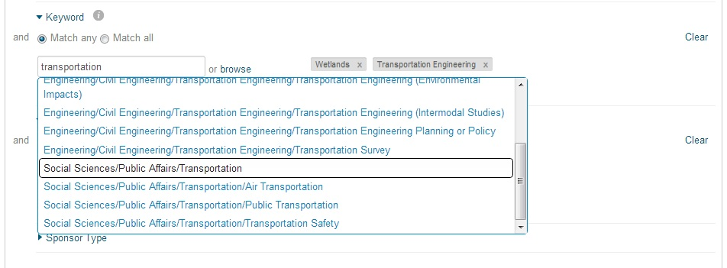
Notes:
Picking the broadest keywords possible will mean a lot of opportunities to sort through, but it also means that you may find opportunities you wouldn’t find searching for funding that specifically targets your exact project.

Slide 18
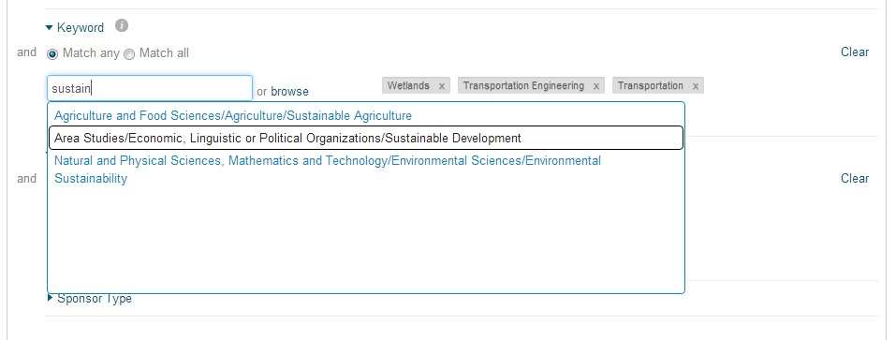
Notes:
Remember to include keywords for which your project is relevant, even if you don’t think of it as the focus of your work.

Slide 19
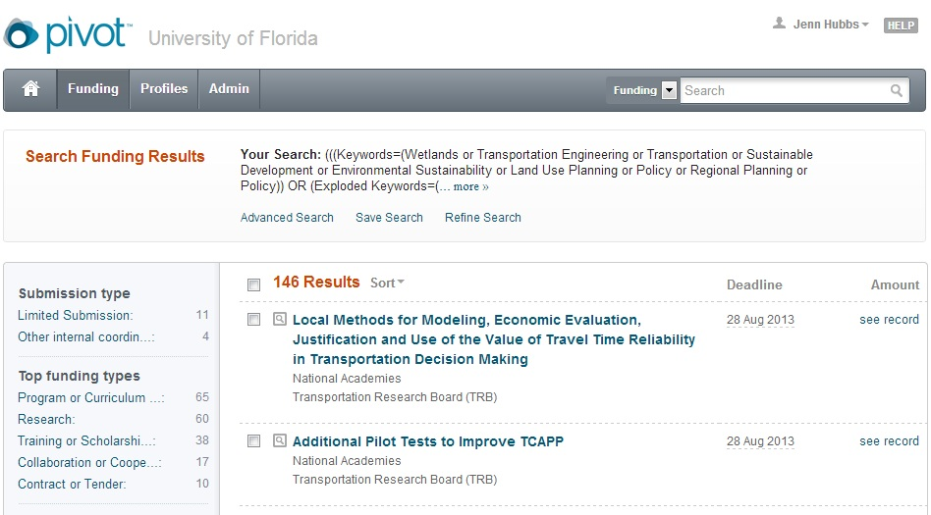
Save to get email alerts
Can use categories at left to look at certain types of funding within your results (other categories further down)
Notes:
Once you have finished picking keywords, you can hit search. We generally immediately save the search (you have to be logged in for this feature). Also, you can use the categories at left to quickly filter the search results.

Slide 20
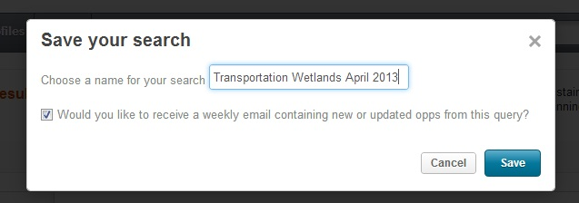
Save to get email alerts – you’ll get one weekly email with new results for all your saved searches – or just check back regularly
Notes:
When you save a search, you can either simply save it, or ask for weekly opportunity updates. This is a great option – Sunday evenings, you’ll get one email listing all of the new results for ALL of your saved searches, so you can set up different searches for different potential projects and just get one email per week.

Slide 21
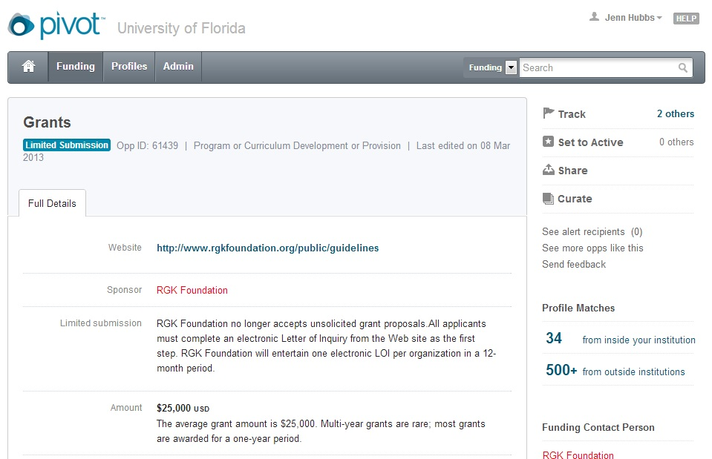
Notes:
When you click through to an individual opportunity, this is what you see. You can use the “track” or “set to active” features to get email alerts whenever the opportunity is updated (for instance, when the next year’s deadline is announced). There is a link to the sponsor website – we recommend you use this to find the best up-to-date and complete details, but you can also read the summary info below (just remember that humans copy it from the sponsor website, and the sponsor website is the set of guidelines that really matters!). The “limited submission” tag at top left means UF can submit only a set number of applications, so please contact our office at limitedprograms@research.ufl.edu to ask what the internal coordination requirements are.

Slide 22
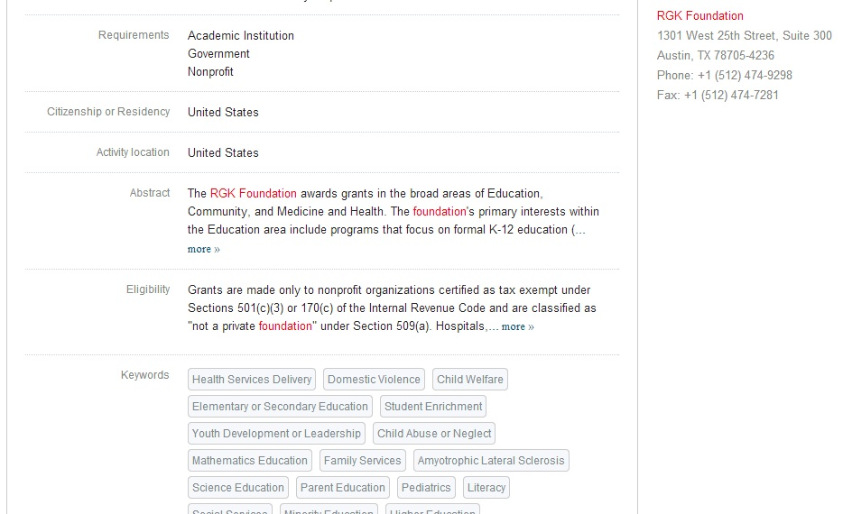
Notes:
Further down, you can see some more info on the program, including the keywords it matches (you may find ones you want to add to your next search!).

Slide 23
Other Email Funding Alerts
NSF (Daily or Weekly)
  http://www.nsf.gov/publications/obtain.jsp
NIH Guide TOC (Weekly)
  http://grants1.nih.gov/grants/guide/listserv.htm
Grants.gov (Daily – all federal opportunities)
  http://www.grants.gov/applicants/email_subscription.jsp
Foundation Center RFP Bulletin (weekly) or daily alerts – and Foundation Center Funding Watches (choose arts, health, or education)
  Available at http://www.foundationcenter.org/ under “Newsletters”
Notes:
Some of the individual ICs (institutes and centers) within NIH, or program directorates within NSF, have individual funding alerts available via their website as well.

Slide 24
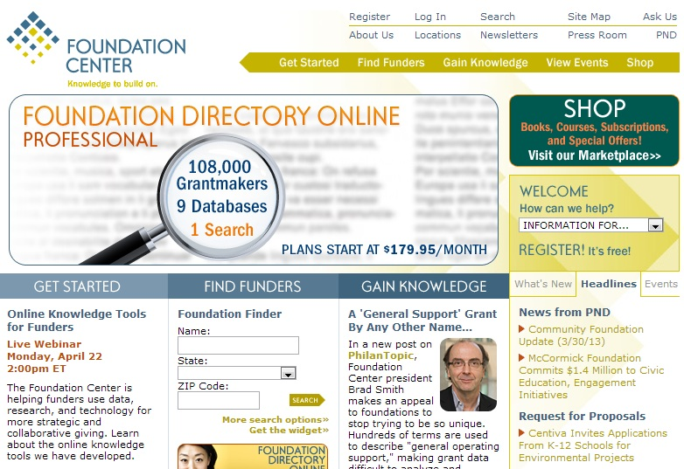
Notes:
The Foundation Center website is available while on UF campus (UF has a subscription). You can use the “Newsletters” link at the top right to sign up for funding alerts.

Slide 25
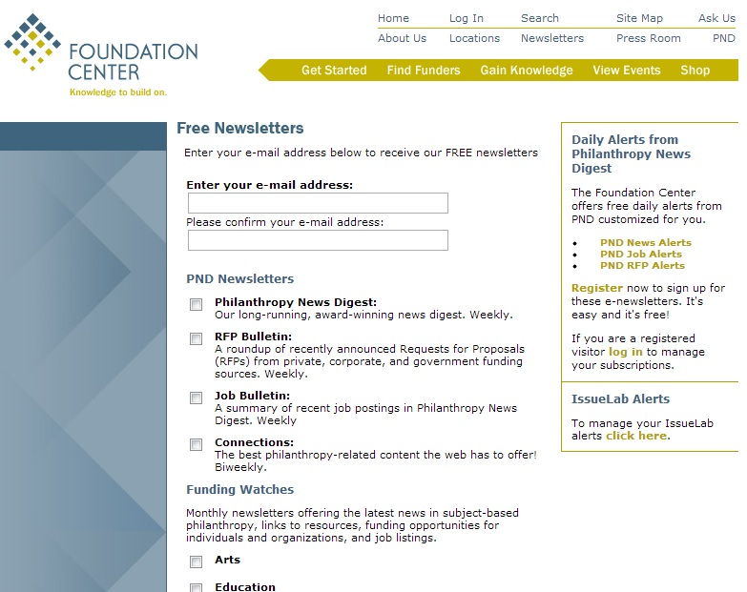
Notes:
There are a number of different subscription options, some with all requests for proposals (RFPs), some with general news, and some with news on funding in specific areas, and they all have different frequencies.

Slide 26
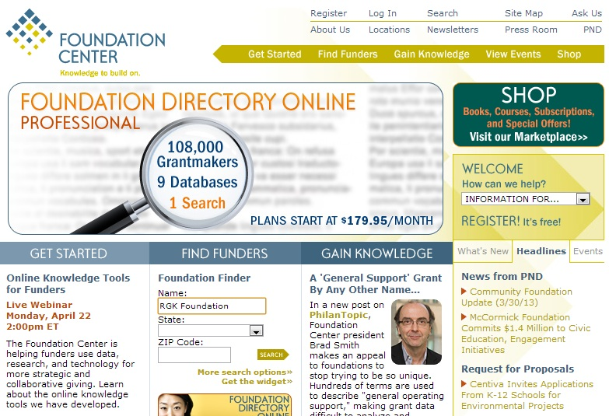
Notes:
You can also use the Foundation Directory website to look up specific foundations you’ve heard about, or to search for local foundations.

Slide 27
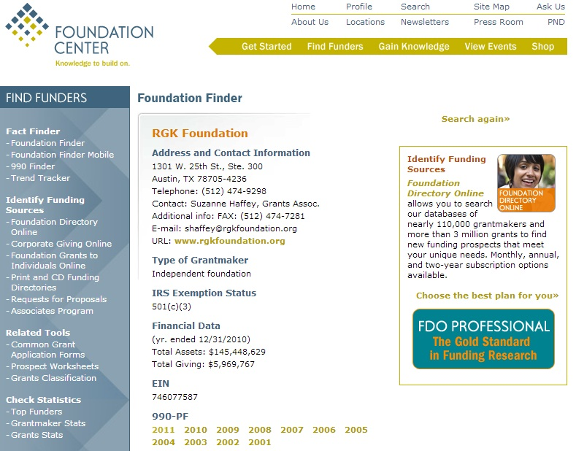
Notes:
On an individual foundation page, you can find contact info (but definitely default to any contact info given on the actual foundation website, or better yet, specifically on the request for proposals – this is just a good piece of information to have if there’s no contact info on the website, but use it with caution), basic stats about the foundation, and at the bottom, a link to their 990 forms from previous years.

Slide 28
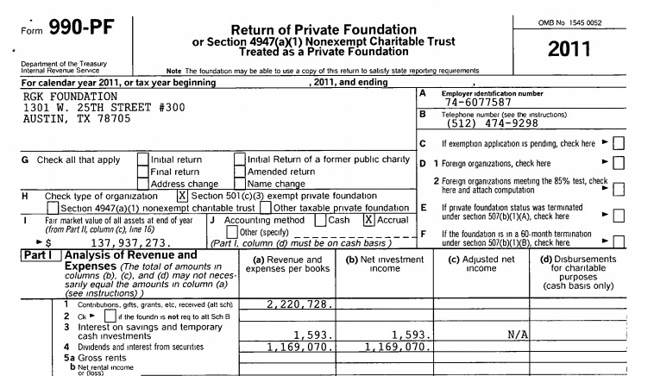
Notes:
The 990 form is a tax form filed by foundations, and further down you will find some potentially useful information that may help you determine exactly what kind of work the foundation is looking to fund, especially if their website isn’t very clear on this.

Slide 29
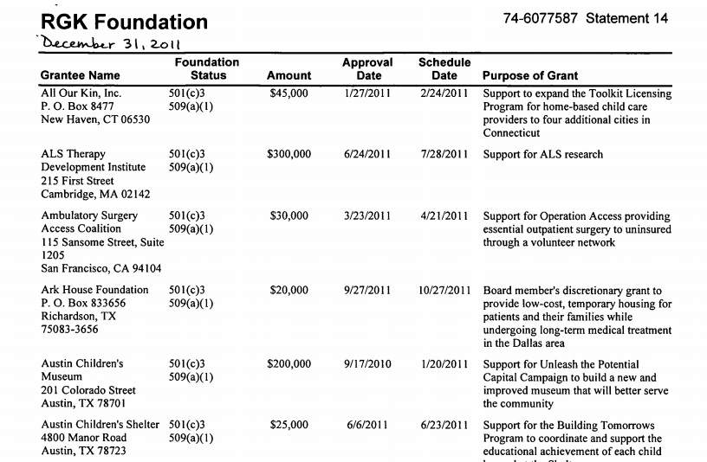
Notes:
The 990 form shows you what grants the foundation made in the year the form was filed. The format varies, and you have to scroll a bit, but this can be very helpful – you can see whether they tend to make grants only to their local area, or if they tend to focus on one or two specific areas, even if this isn’t stated on their website. For instance, if I kept going I would learn that RGK Foundation does make a lot of grants in their local area (near Austin, TX), but at least half are outside that area, some very far away. I’d also see how big their grants usually were, and that they seem to fund a lot of community charitable work and ALS research.

Slide 30
Other Web-Based Resources
List of external funding resources (e.g. “Graduate Student Funding Sources”) available at http://research.ufl.edu/research-program-development/external-funding.html
GrantForward – available on the UF Libraries website - http://www.grantforward.com
www.Grants.gov (single Federal portal)
Links to Federal Agencies - http://www07.grants.gov/search/agency.do
Links to Private Foundations – www.foundationcenter.org
UF Funding Opportunities page Search Function
  www.research.ufl.edu/funding

Slide 31
UF Libraries Grant Resources
http://www.uflib.ufl.edu/funding/workshops.htm
  Workshops for Students – Videos available online
  NSF Workshops
  NIH Workshops
  General Grant Writing Workshops (Bess de Farber)
  Others (McNair Scholars, Fulbright, Museums)

Slide 32
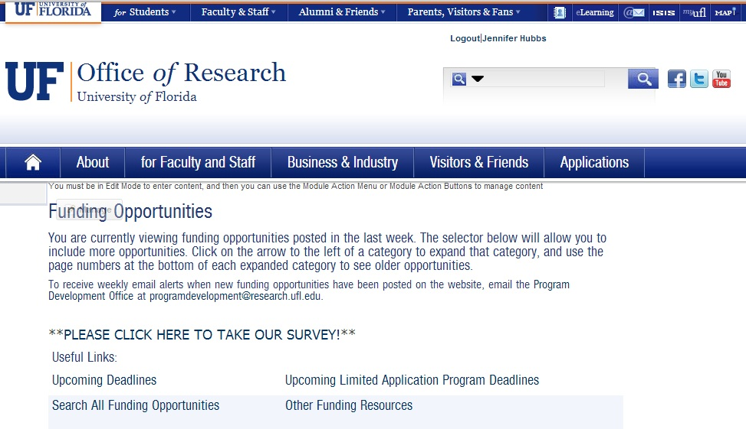
UF Funding Opportunities Page
Published weekly (Fridays) – www.research.ufl.edu/funding
Requires Gatorlink login
Notes:
Our office puts this together each week. It includes a list of all funding opportunities we’ve found (we try to get everything, but we can’t promise that we do!) that UF is eligible for and likely to have applications for. You can sign up for a once-weekly alert when we’ve updated it, and also search it to see if we’ve published anything in a specific area. This is also where we publish internal deadlines for limited application programs (mentioned earlier).

Slide 33
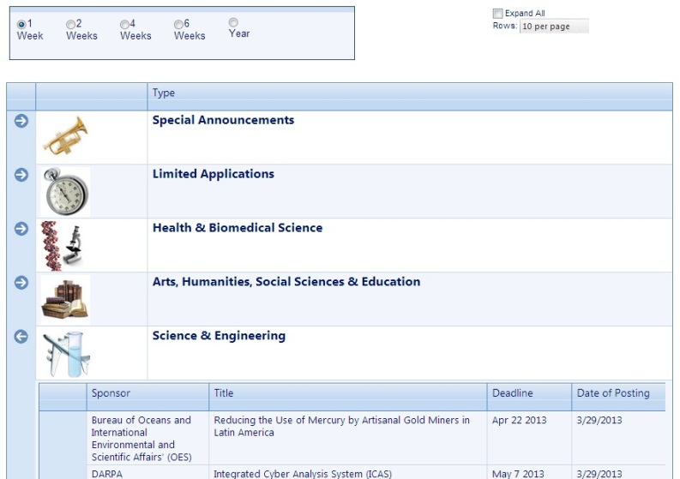
Notes:
Scrolling down, you can expand each section using the arrow at left to see what we published recently, with links to either the sponsor website or the internal announcement, as well as the next deadline coming up. You can use the radio buttons up top to see more weeks of results, or go to the “Upcoming Deadlines” page (link near the top) to sort by deadline.

Slide 34
Getting Started
Identify potential sponsors
  Subscribe to funding alert email services; funding searches
Make a calendar of upcoming submission deadlines – DON’T MISS THE OPPORTUNITY!!
Compile background on sponsors - find the agencies that fit your needs
  What does the agency want to fund? What is their process?
  Check their website, recent grant awards, annual reports, talk to the program officer
Questions to consider:
  Are you or UF eligible to apply?
  Will they fund what you need? Average award amount? Cost-sharing?
  Can you meet the deadline?
Talk to funded colleagues
Apply for internal or small grants
Partner with successful PI
Volunteer to review proposals
Revise & resubmit

Slide 35
DSR Pre-Award Office ufproposals@ufl.edu or 392-9267
This is the office that will help you submit your already-prepared grant application.
Budget development assistance
DSR-1 form
MUST have signatures from Chair, Dean and then finally the institution
Review, sign and send proposals to the funding agency
Contract negotiation
Electronic proposal submission
Notes:
They are your friends!

Slide 36
DSR Post-Award Office ufawards@ufl.edu or 392-5991
Receives award notices from agencies
Generates internal Notice of Award Acceptance to campus accounting offices
Reviews, interprets award regulations
Negotiates subcontracts to awards
Approves no-cost extensions
Close-out transactions & reports

